Slide 1

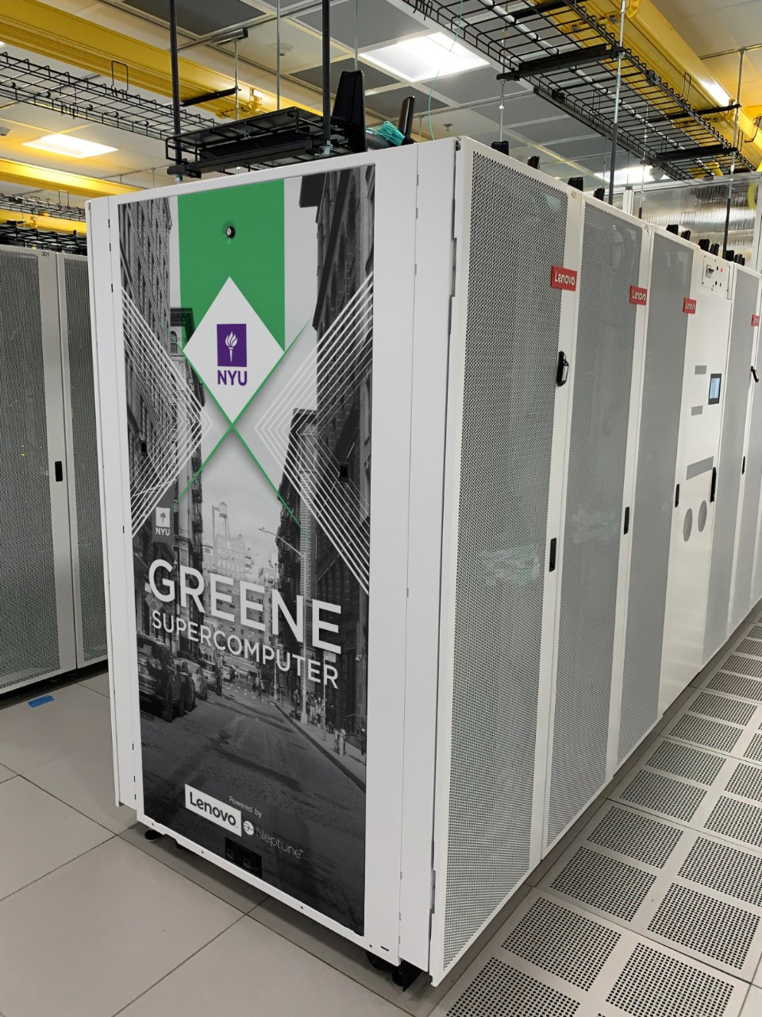
REPRODUCIBILITY
Abdul Agha, Arthur Barbosa, Pratham Mehta, Riku Santa Cruz, Yams Gupta
Github: https://github.com/ama10047/Reproducbility-Challenge-SCC23
Website: https://sites.google.com/nyu.edu/reproducibilitychallenge-scc23/home

Slide 2

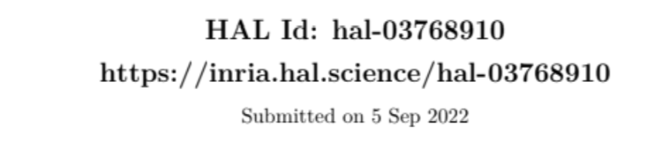
Enhancing SBC by Cholesky Factorization
Authors: Olivier Beaumont, Philippe Duchon, Lionel Eyraud-Dubois, Julien Langou, Mathieu Vérité.
Conference: SCC 2022 - Supercomputing, Nov 2022, Dallas, Texas.
Focus: Improving dense Cholesky factorization through a new data distribution method; Lowers storage space…
SBC: Symmetry Block-Cyclic Distribution

Slide 3

Reproducibility Challenge
Reproduce the experiment from the SCC 22 paper and determine the efficacy of this Cholesky factorization of matrices
Setup chameleon and dev environment on NYU HPC Greene Cluster
Generate our own tests and graphs of the experimental setup
gw.hpc.nyu.edu

Slide 4
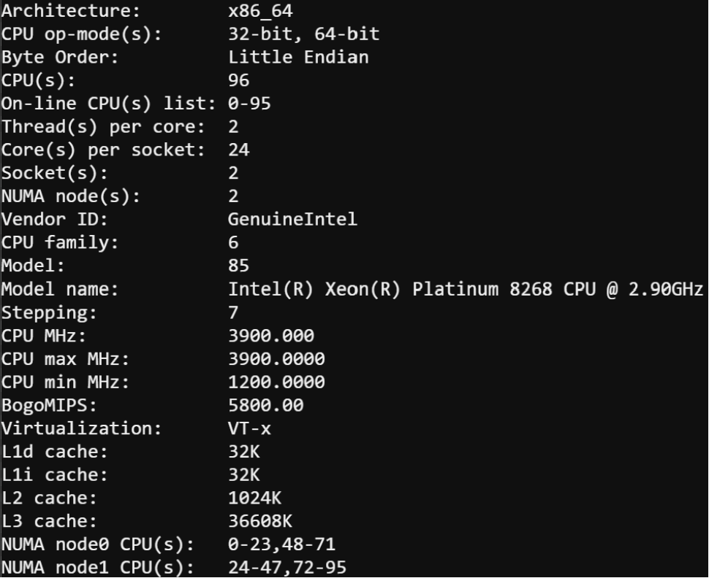
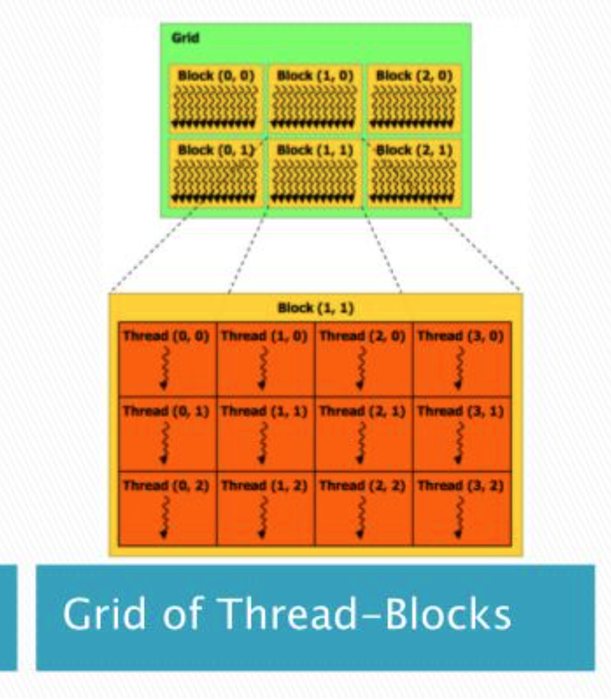
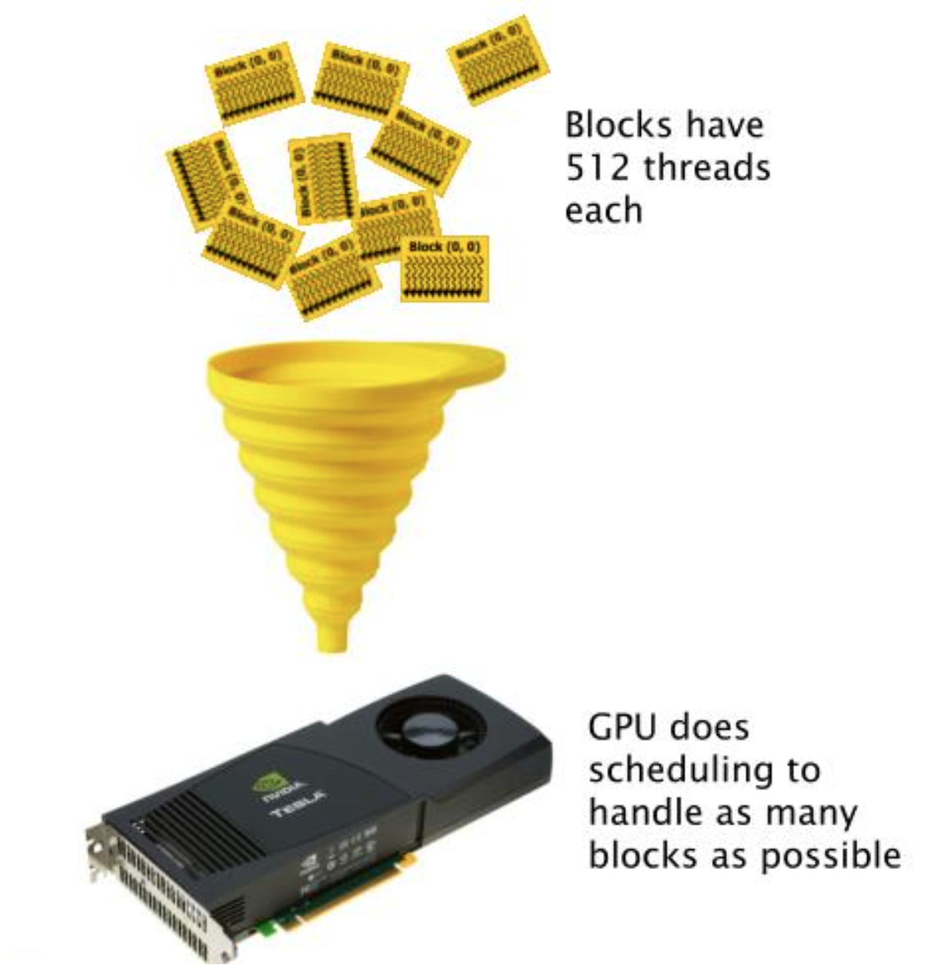
System Architecture

Slide 5
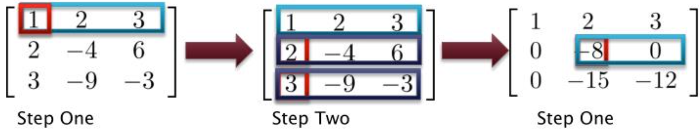
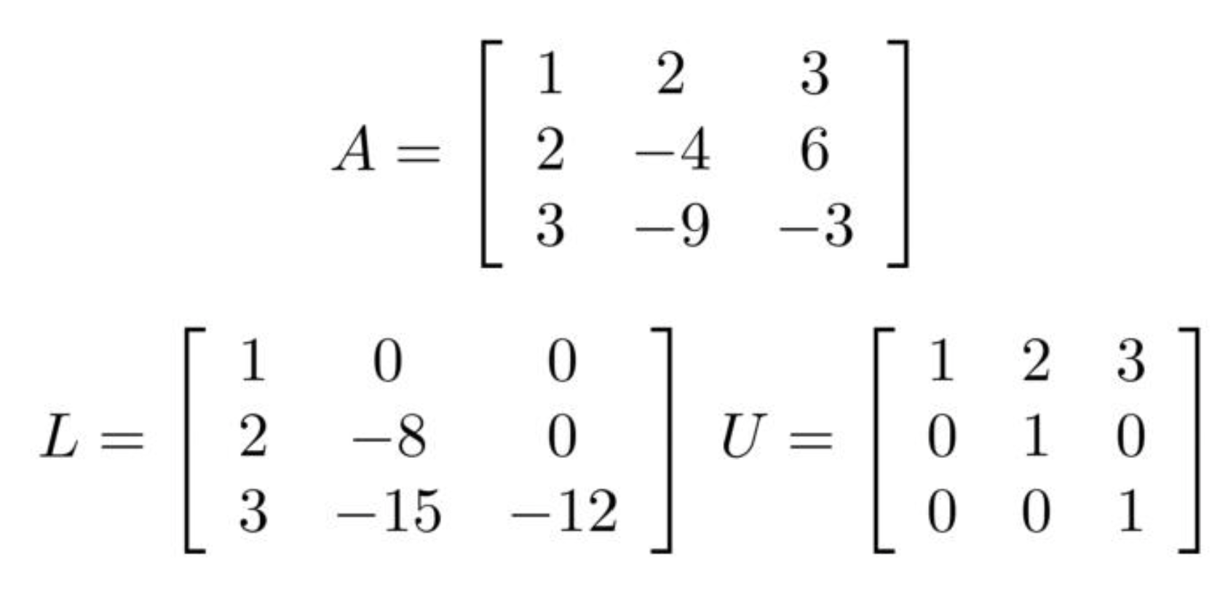
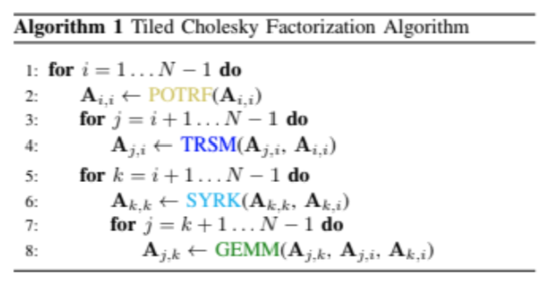
Linear Algebra Functions Used
LU: Factorization decomposes any square matrix into a lower (L) and an upper (U) triangular matrix. It’s a general method for any square matrix.
Cholesky: Factorization is a specialized method for symmetric positive-definite matrices, decomposing them into a triangular matrix and its transpose. It’s more efficient for matrices that meet its criteria.

Slide 6
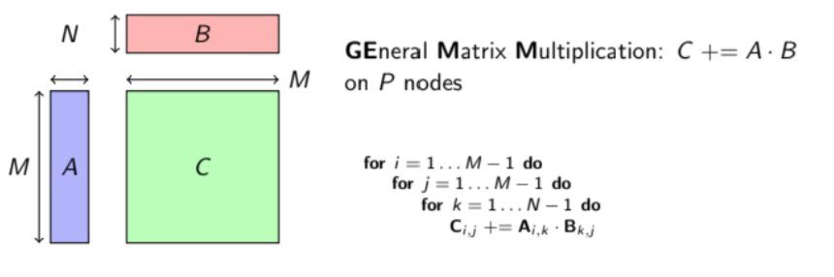
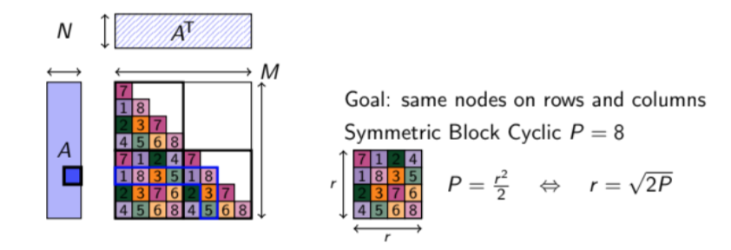
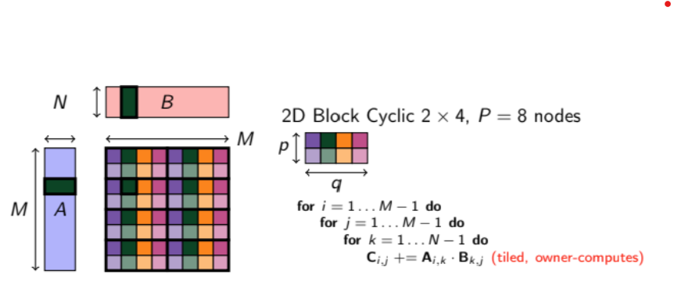
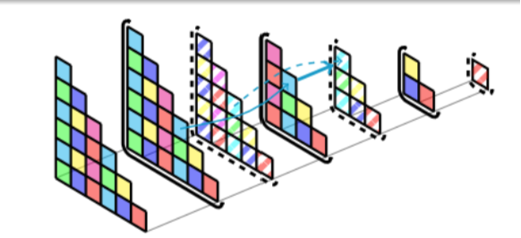
Linear Algebra

Slide 7
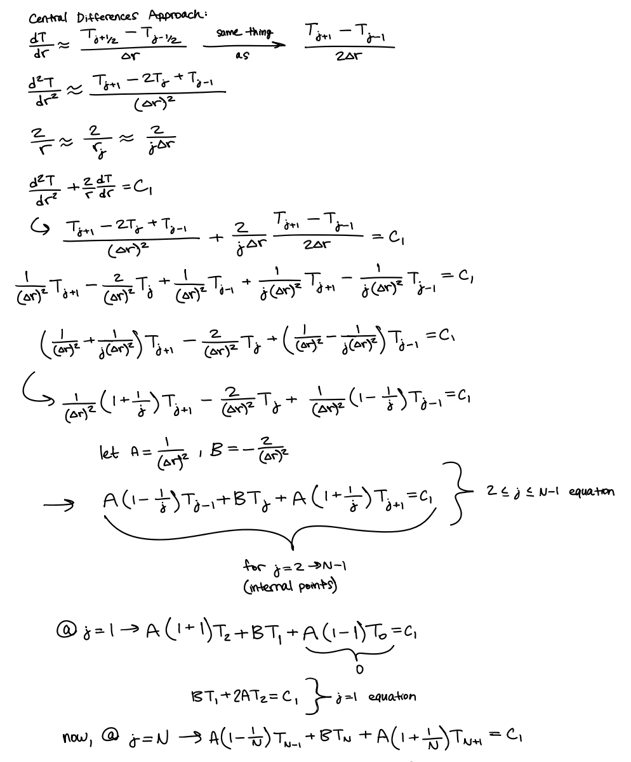
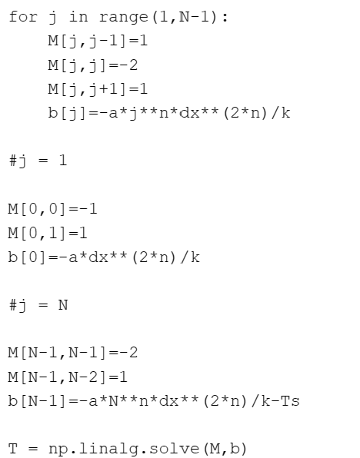
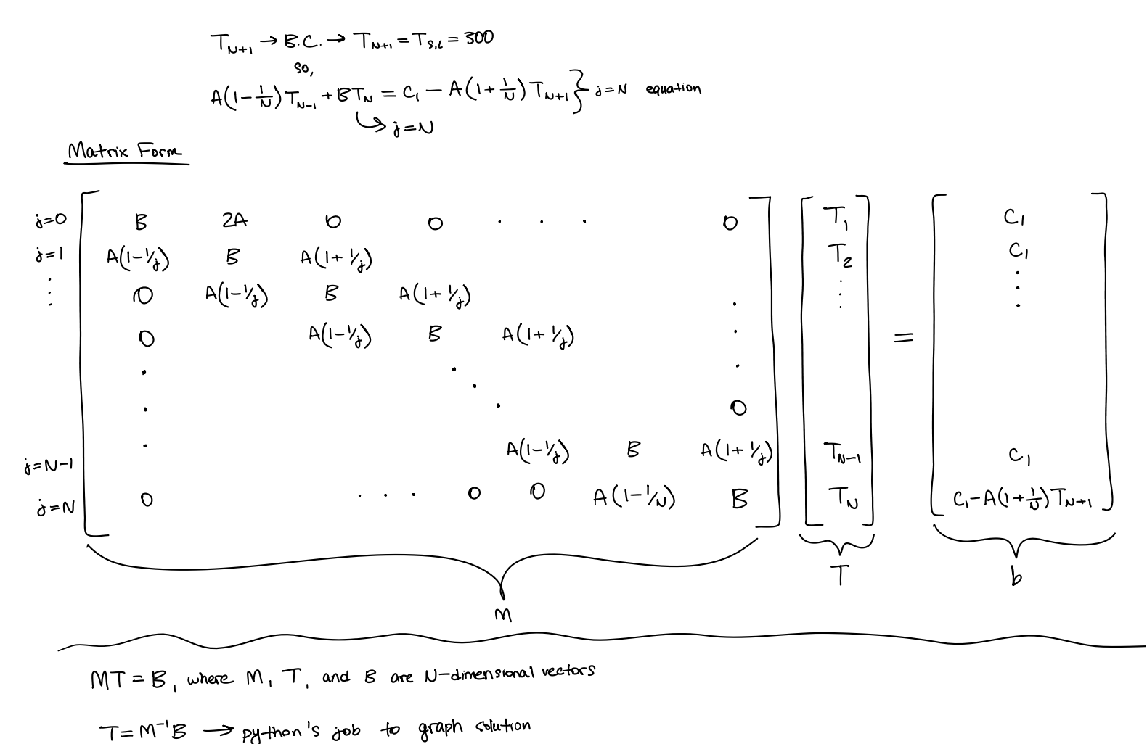
Matrix Multiplication in Code

Slide 8
Matrix Multiplication
Tiles require a specific node, P1, to access the value of a tile Ai,j owned by another node, P2, during task execution.
In these cases, the runtime system takes charge of initiating communication to request the transfer of tile Ai,j to P1.
This transfer allows P1 to use the tile as input for task execution. It’s crucial to emphasize that despite this transfer, the ownership of the tile remains with P2.
P2 continues to store the data, and all future requests for this tile will still be directed to P2.

Slide 9
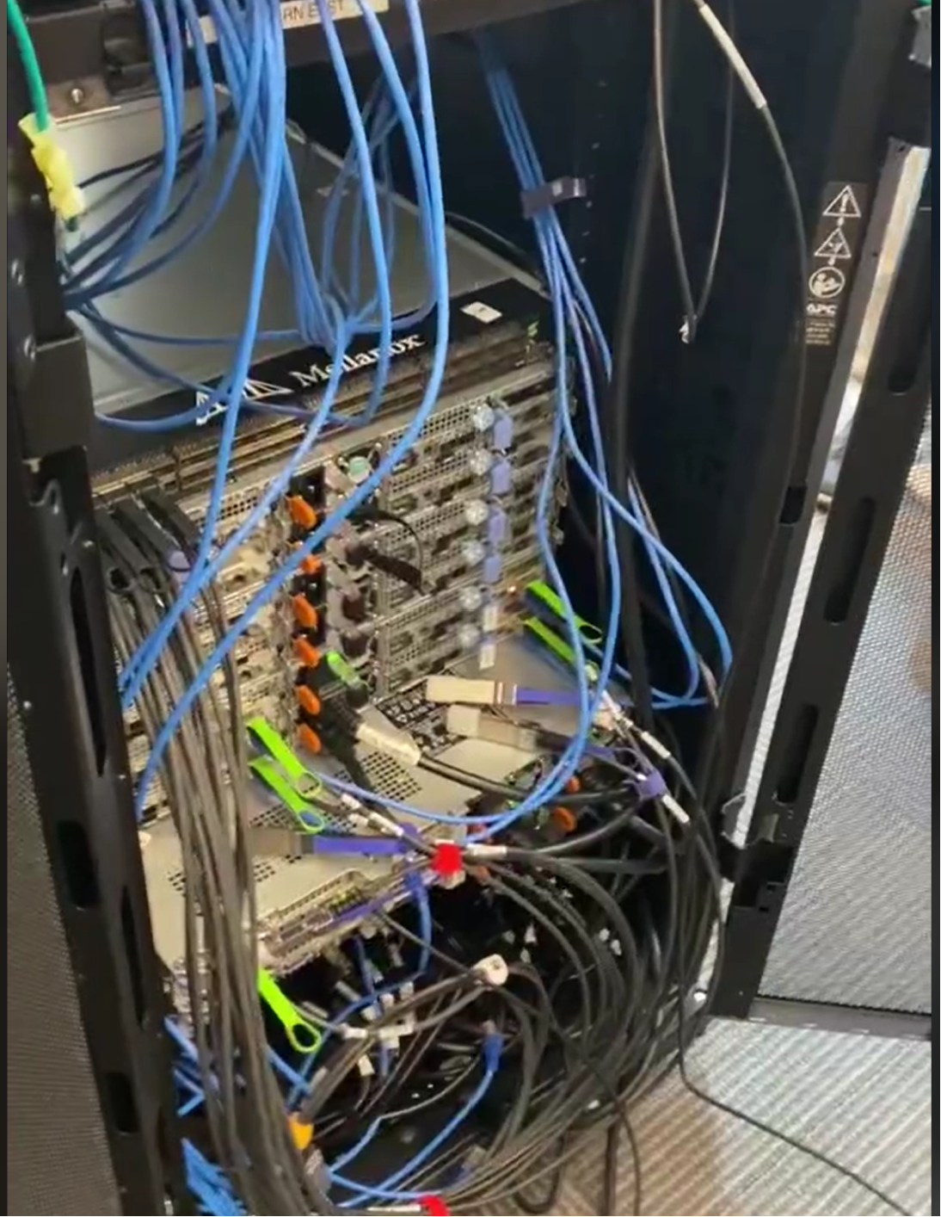
Symmetric Block-Cyclic (SBC) Distribution
SBC: A new approach tailored for Cholesky factorization designed to exploit matrix symmetry
Achieves load balancing similar to 2D block-cyclic but with reduced communication volume
SBC reduces communication volume between nodes by √2 compared to standard 2D block-cyclic distribution
Clusters: CPU Node / GPU Node

Slide 10
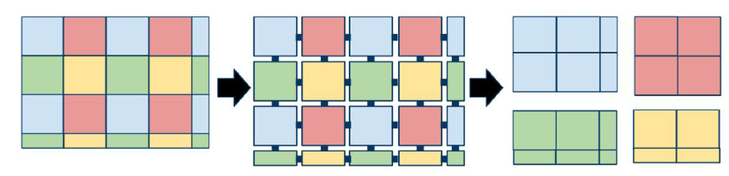
Scalable Linear Algebra PACKage
A library for high performance clusters to work with Linear Algebra;
Traditional approach: 2D block-cyclic distribution in ScaLAPACK;
Task-based runtime systems allow more optimized data distribution;
The new 2.5D block-cyclic distributions offer improvements but don't fully utilize matrix symmetry.

Slide 11
Supposed Tests
Benchmark and compare 2D and 2.5D block-cyclic distributions;
Integration with task-based runtime systems like StarPU;
By reducing communication volumes and optimizing data transfers, these algorithms should offer substantial improvements in computational efficiency.

Slide 12
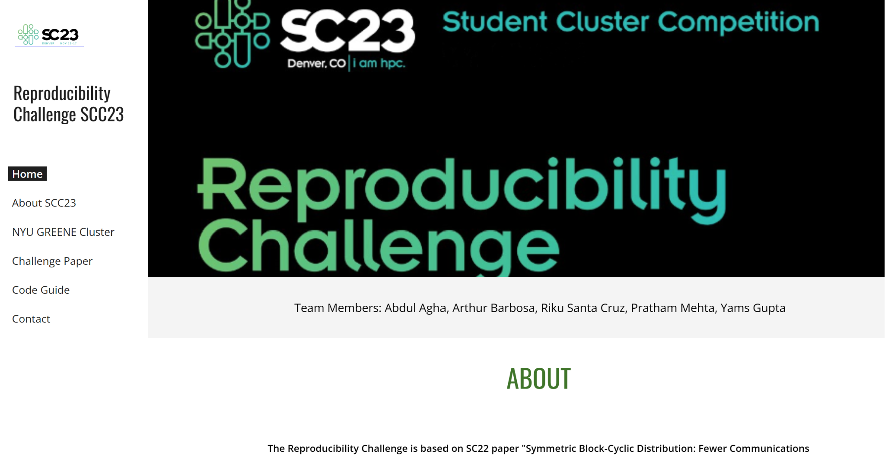

Website - SCC 23
Reproducibility Challenge SCC23 (google.com)

Slide 13
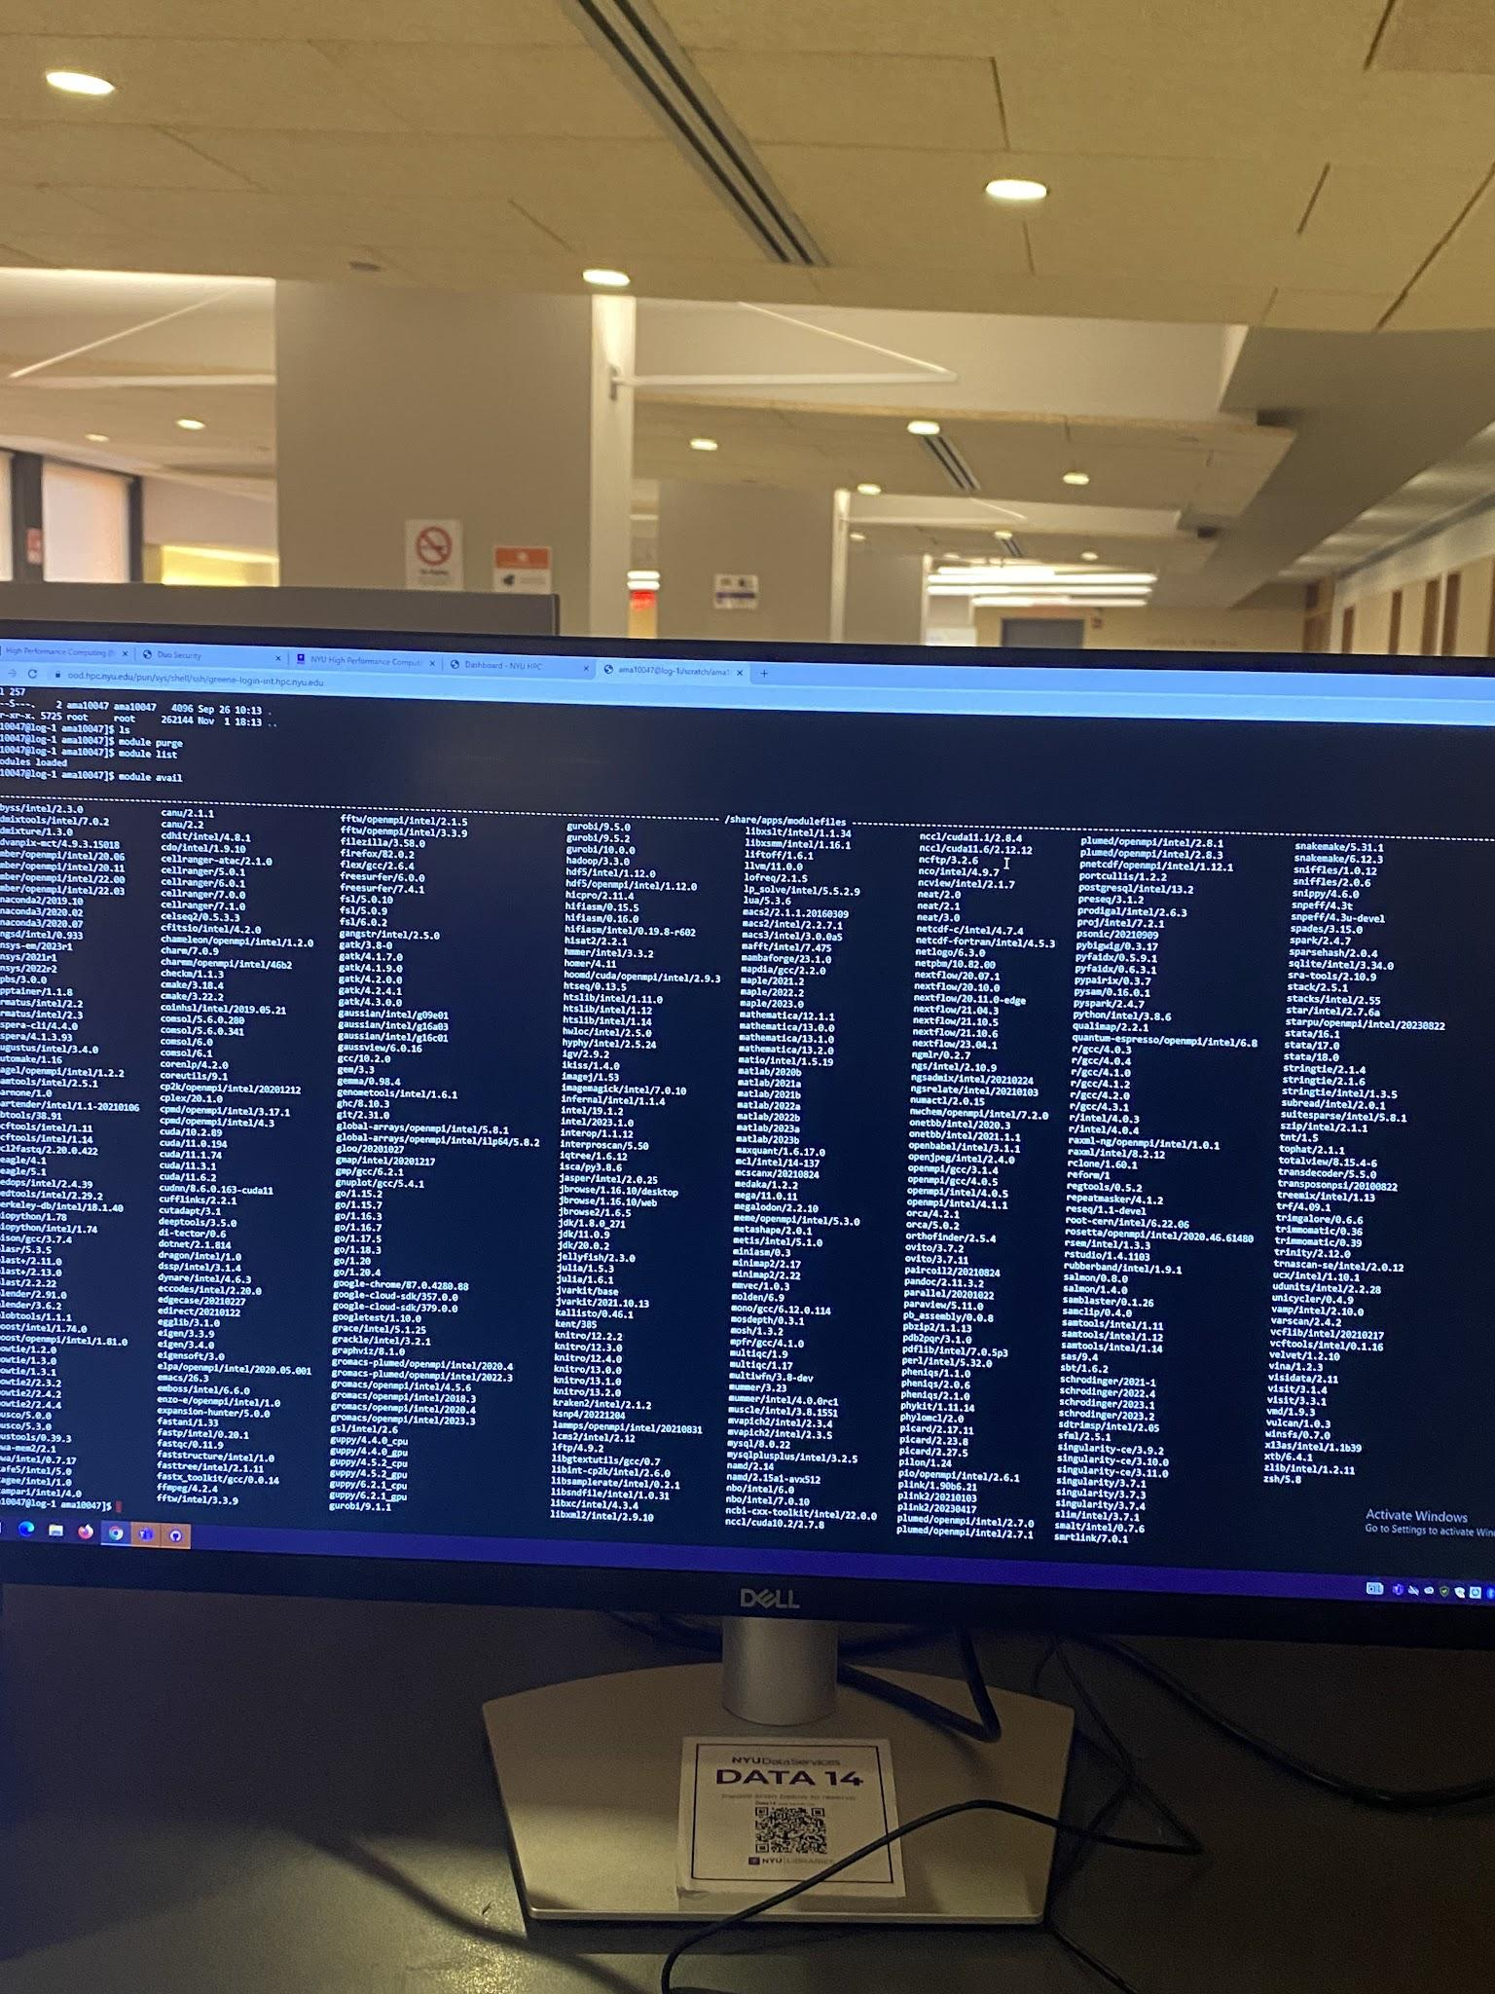
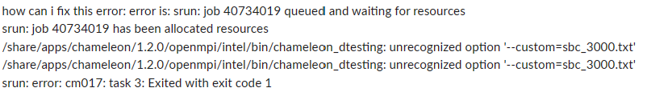
Previous Progress
Implementing tests
Understanding errors
Experimenting
Graphs Set Up
Chameleon Installation
Linux Issues

Slide 14
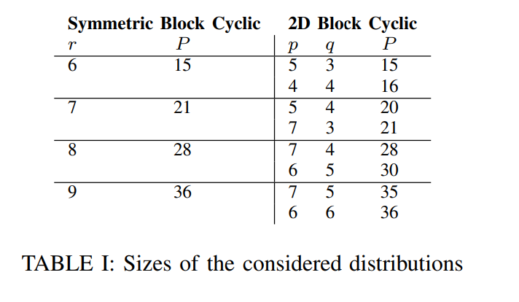
Paper Requirements (Distribution)
P represents the total number of nodes, while p and q denote the layout configuration within each node for the 2D Block-Cyclic (2DBC) allocation scheme. P corresponds to the total nodes used, while p and q define the number of blocks in each dimension within a node, influencing data distribution and communication patterns for Cholesky factorization.

Slide 15
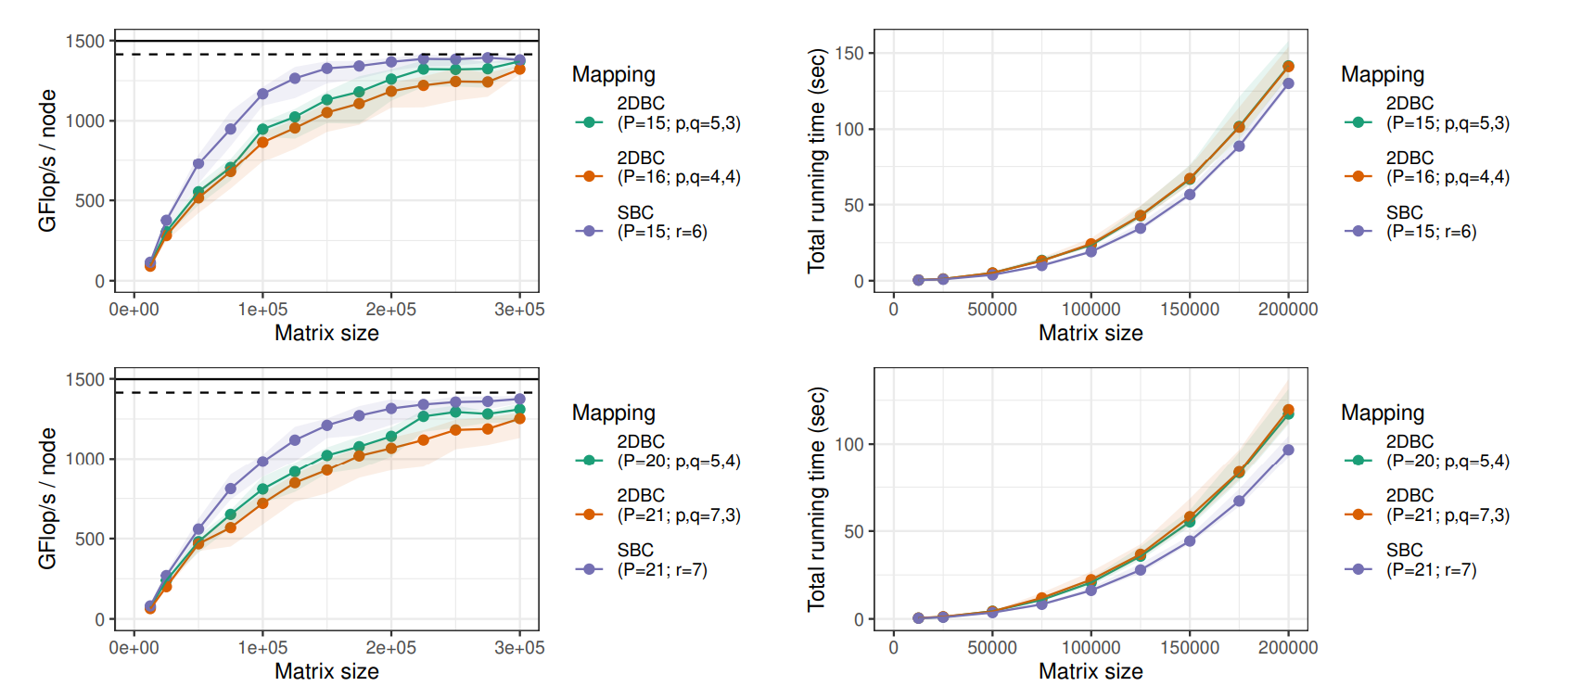
Paper Requirements (Technical)

Slide 16
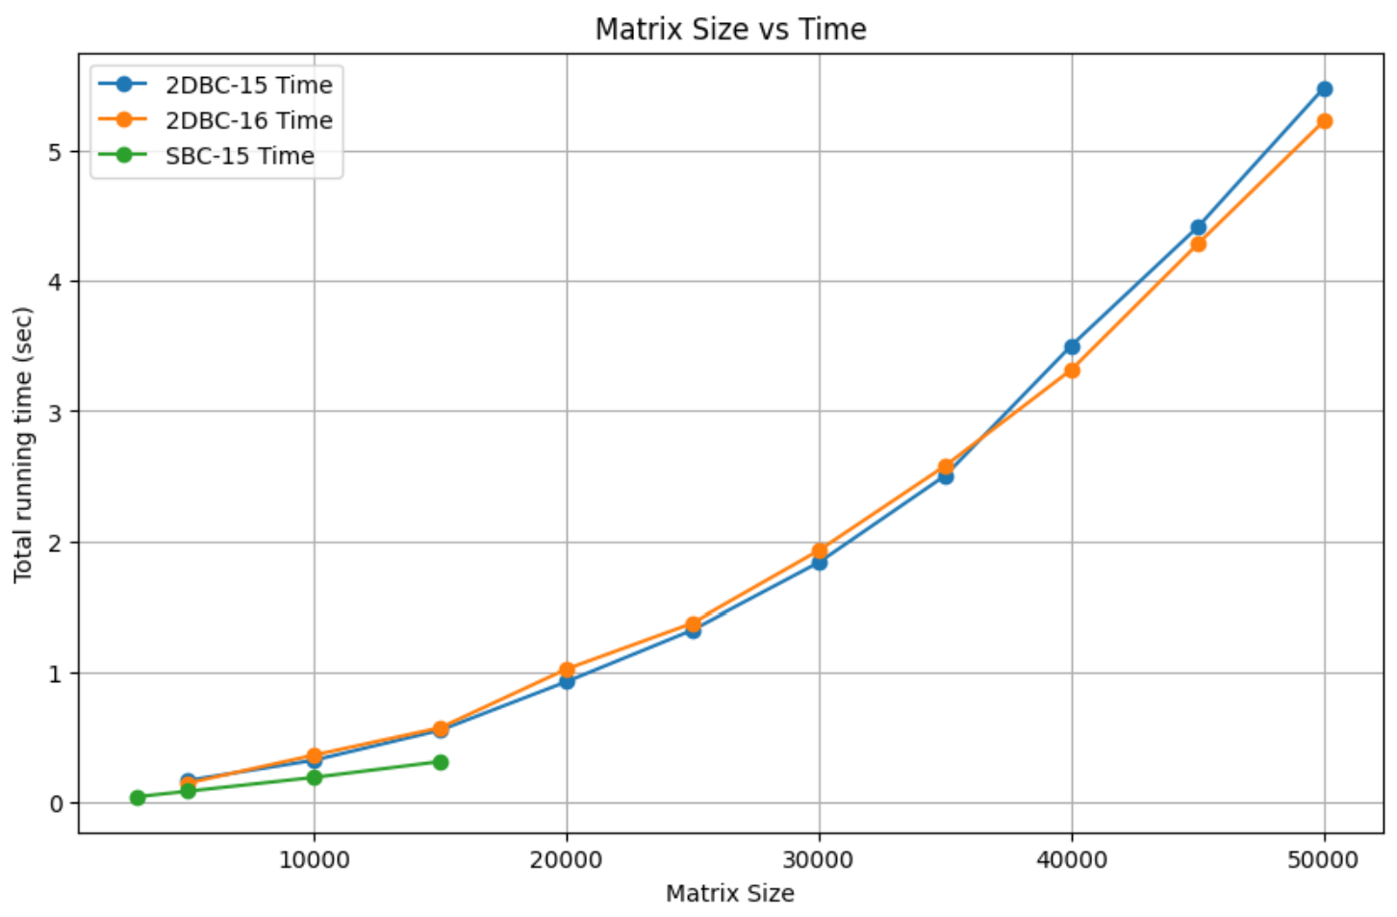
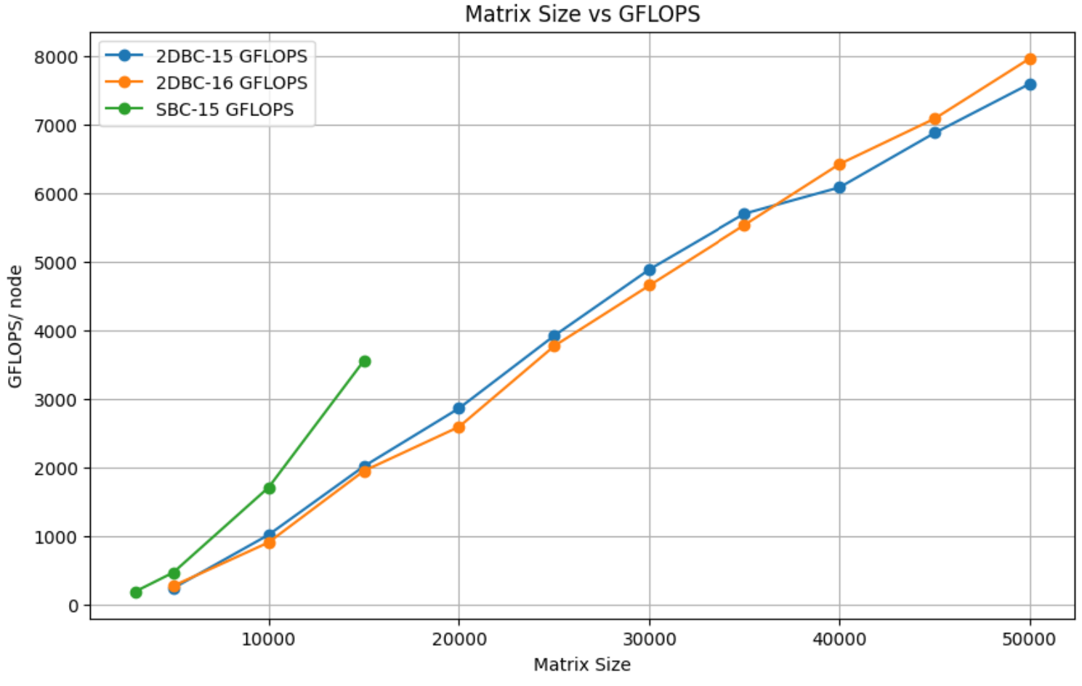
Reproduced Results

Slide 17
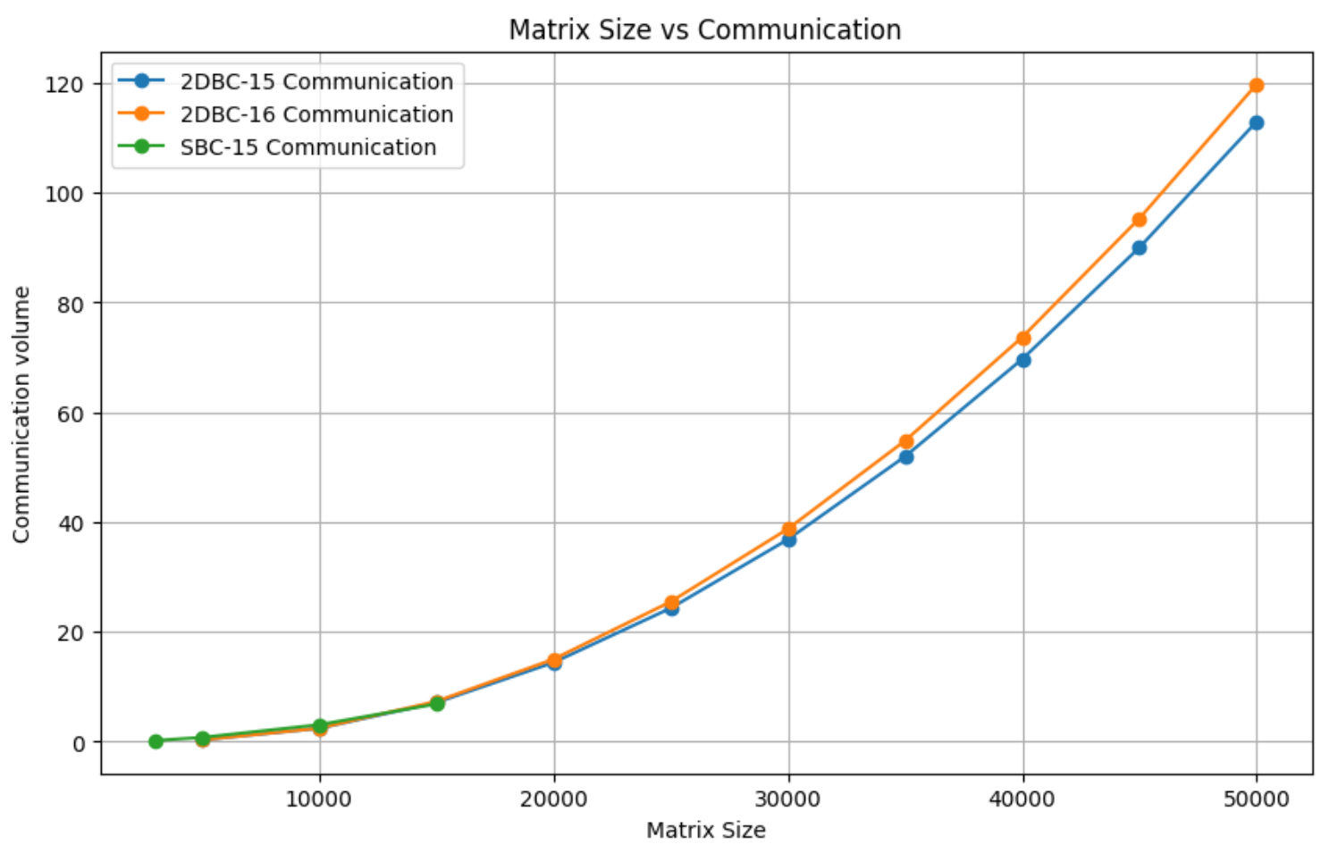
Reproduced Results

Slide 18
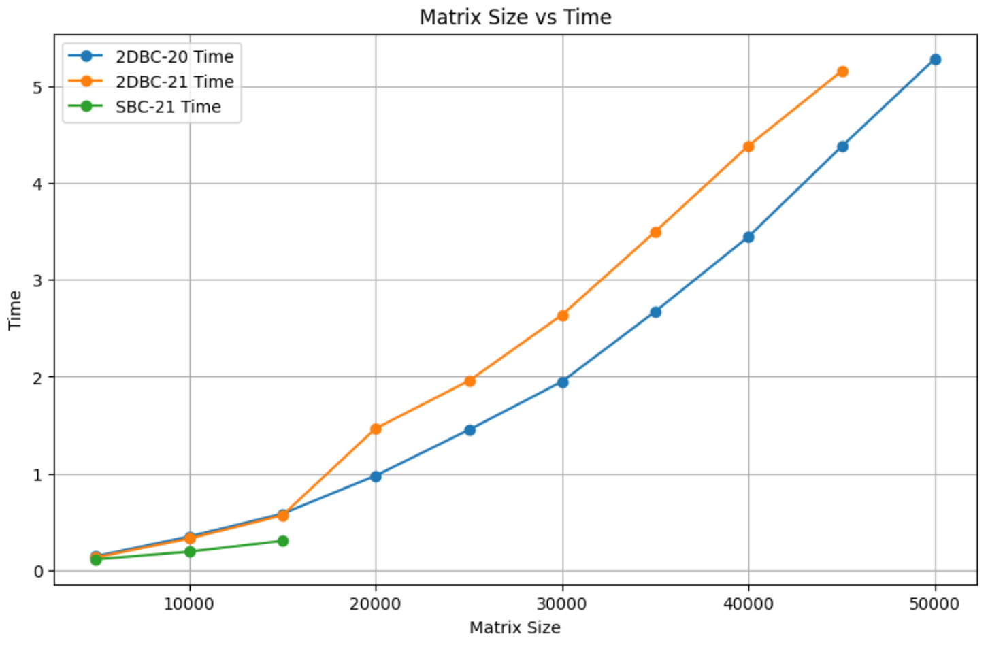
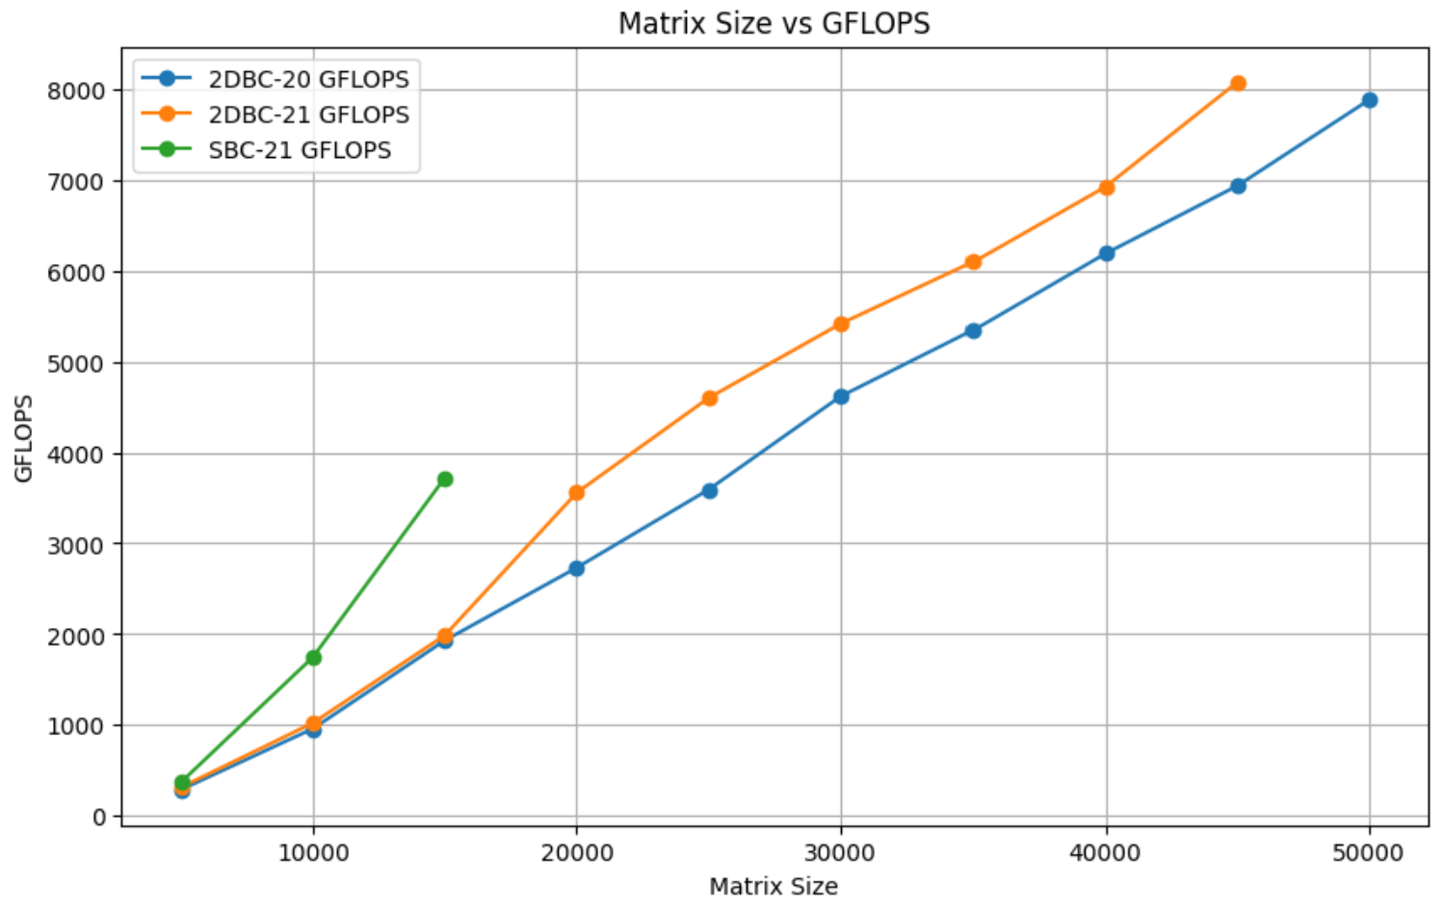
Reproduced Results

Slide 19
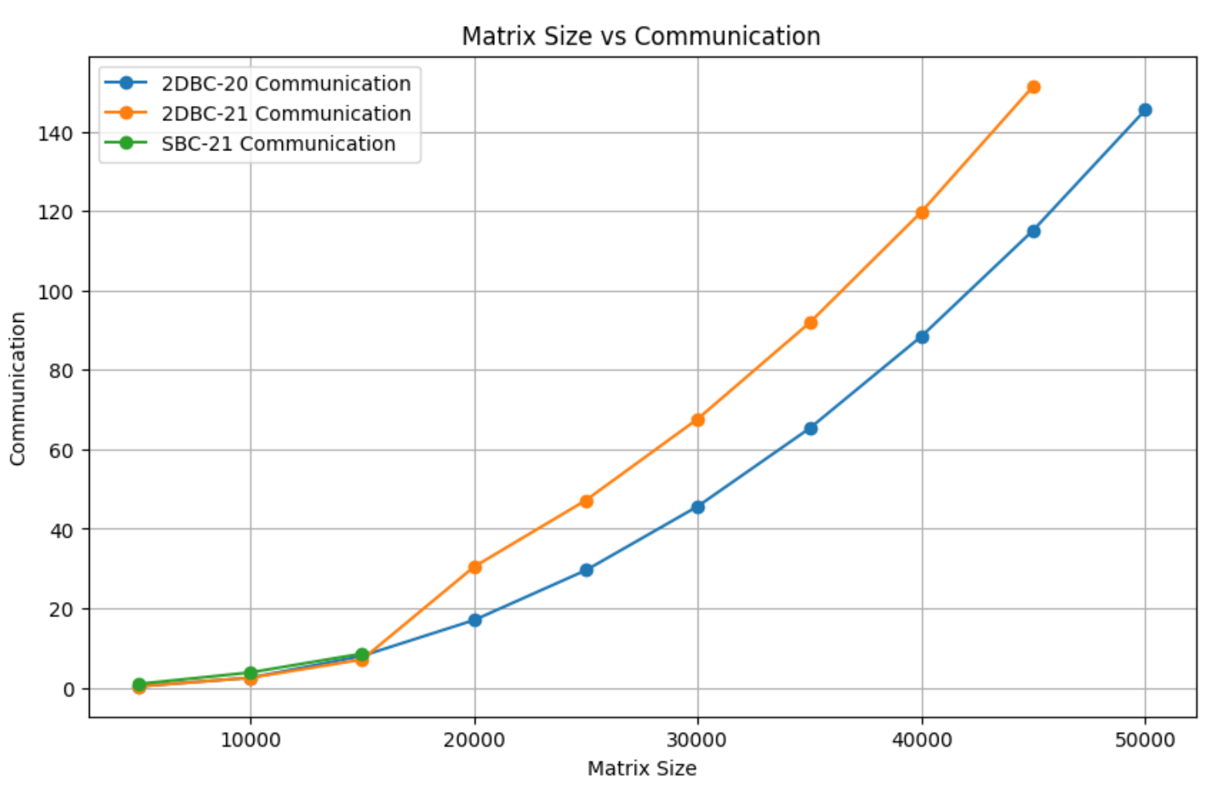
Reproduced Results

Slide 20
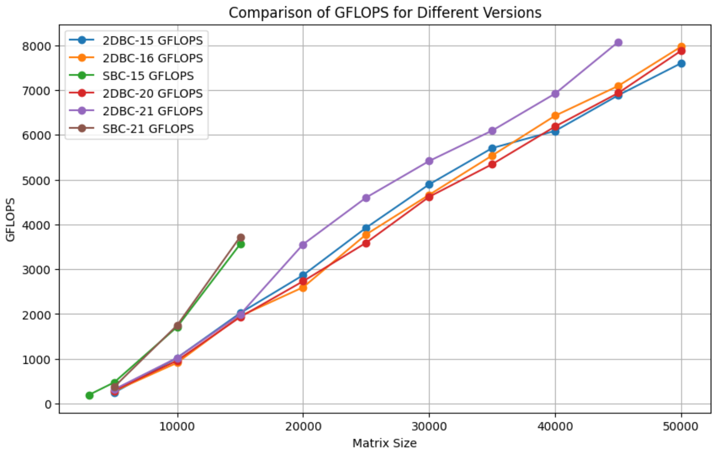
Final Graph
The graph represents the performance of various algorithms (2DBC-15, 2DBC-16, SBC-15, 2DBC-20, and 2DBC-21) across different matrix sizes.
It reveals a trend of enhanced computational efficiency with larger matrices.
However, distinct algorithms exhibit differing rates of performance improvement, underscoring the influence of algorithmic variations on computational speed as matrix complexity increases.

Slide 21
RECAP
The experiment proposed by SCC 2022 Inria Hal of Science, was tested to prove that 2DBC and SBC can be enhanced by lowering size and run time through high linear algebra operations that involves a node & Block division process.
Conclusion
Our experiments confirmed the original paper’s findings: SBC significantly reduces communication needs and improves overall performance and scalability in dense Cholesky factorization tasks. This was evident in our tests across various matrix sizes and performance metrics.

Slide 22
Possible Areas of Research
Extending the SBC approach to other matrix operations;
SBC presents a significant step forward in efficient Cholesky factorization;
Balances load effectively while minimizing communication overhead;
Opens avenues for more efficient parallel algorithms in linear algebra.
Extend the Algorithm into different shapes

Slide 23


THIS WAS REPRODUCIBILITY
By: Abdul Agha, Arthur Barbosa, Pratham Mehta, Riku Santa Cruz, Yams Gupta
And all Other Collaborators; specially Shenglong & Sid
(ama10047 atb8655, pm3483, rs8057, ag7432)@nyu.edu

